Slide 1
Computer Systems & Networks An overview
Frank Walsh

Slide 2
Agenda
Main Topics
Computer Systems & Architecture
Operating Systems
Communication Networks
Cloud Platforms
Tools and technologies
Ethos

Slide 3
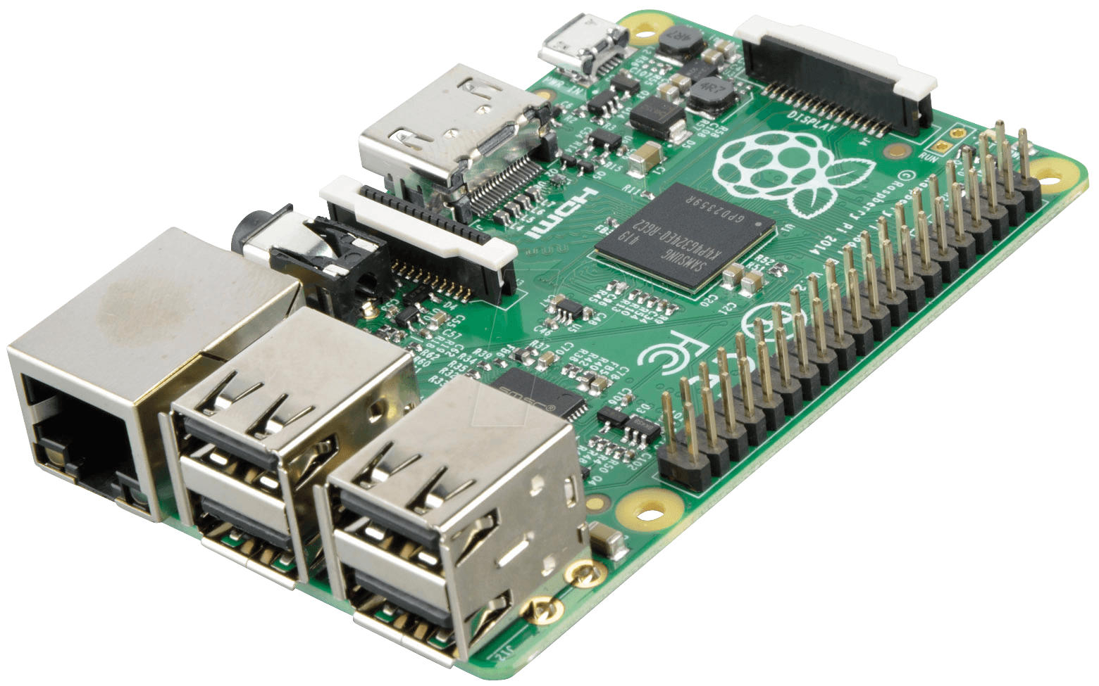

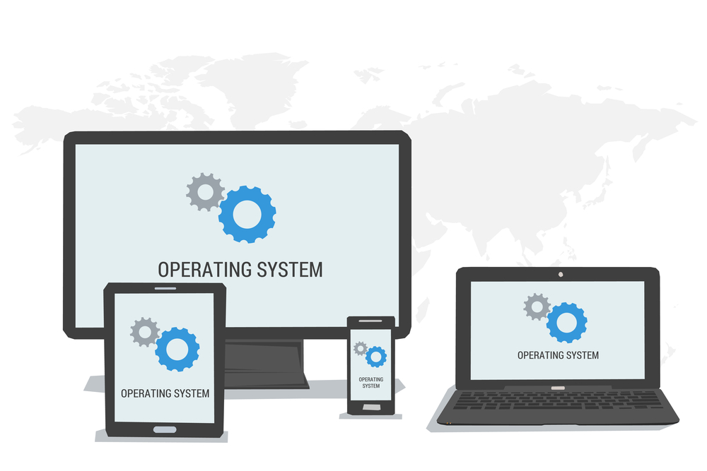

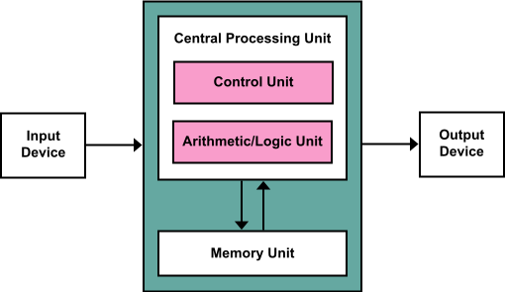
Main Topics
Notes:
Computer Architecture and Systems:
Find out how computer systems are organised and how they function. For example how memeory is used, how CPU/ALU and Memory interact. Data and number representation in digital computer systems. Boolean Logic, Techniques for improving computing performance: Pipelining and super-scaler processing., Input /output.
Operating Systems:
Software that manages a computers hardware and software resources. Provuides common sevices. Emphisis on Linux here. File systyes, CLI, Bash ans Shell scriptsings.
Computer Networks:
Data Communication technologies and protocols. How computing devices can use data communication networks to interact. Use protocol analysis software to investicate various communication protocols. TCP/IP, IP addressing. Also look at some wireless technogies such as WIFI and Bluetooth. Application layer protocols such as HTTP FTP DNS
Cloud:
Explore key technologies in provisioning and interacting with cloud services. Examine how cloud services and applications are deployed and managed. Specifically look at Internet of things cloud platforms platforms .

Slide 4


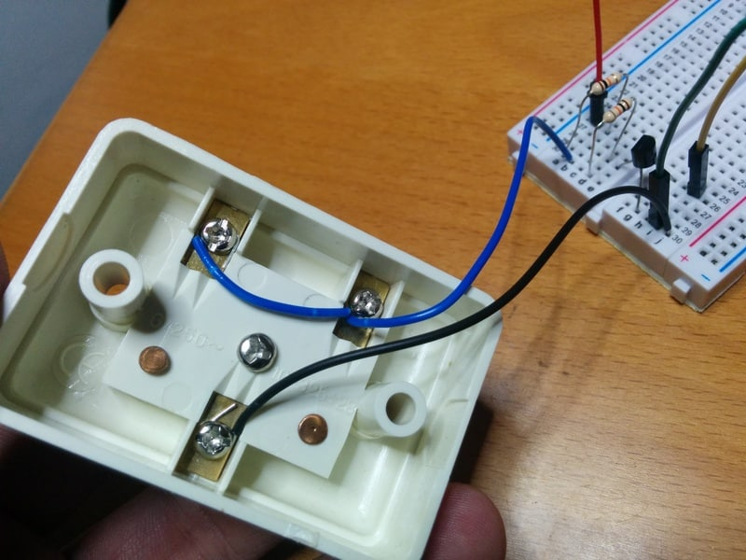
Tools and Technologies (tentative)

Slide 5
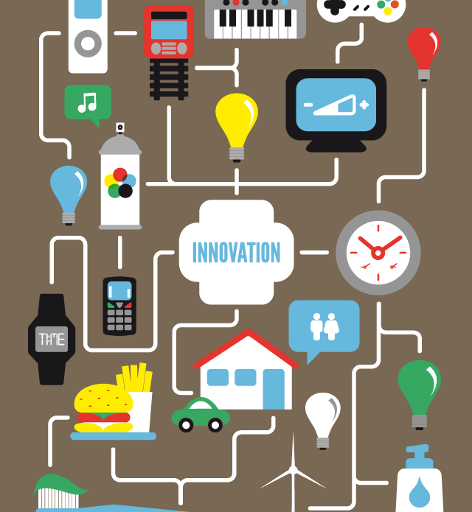
Ethos
Module will encourage “permissionless innovation”
Encourage the inclusion and experimentation of various devices and technologies
Lab programme will focus on particular devices/platforms
However feel free to connect and incorporate your own personal devices in assignments

